Slide 1

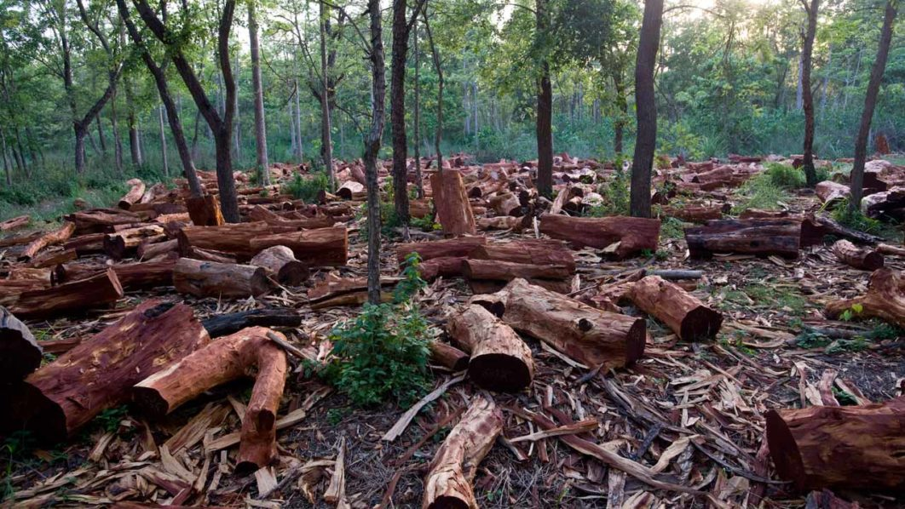

Classifying And Examining Deforestation Patterns And Its Environmental Implications

Slide 2


ABSTRACT
The study aligns with SDG 13 by addressing deforestation's role in climate change, affecting carbon sequestration and greenhouse gas emissions.
Forests act as crucial carbon sinks, but degradation releases stored carbon, contributing to global warming.
Deforestation also releases methane and nitrous oxide, intensifying the greenhouse effect.
Large-scale tree removal disrupts climate patterns, impacting temperature, precipitation, and humidity.
This research underscores the urgency of climate action, recognizing SDG 13's paramount importance in the current environmental context.

Slide 3





PROBLEM STATEMENT
Deforestation affects the local climate by altering sensible and latent heat flux, precipitation, and albedo.
On the global level, deforestation has resulted in a net release of carbon dioxide and other greenhouse gasses into the atmosphere.
Deforestation in Maharashtra, India's second most industrialized state, is driven by factors like urbanization, agriculture, and industry, causing environmental and socioeconomic impacts.
Over the past three decades, the state has lost 1,610 sq km of forest, reducing the current forested area to 17% of the total land.
Illegal activities such as tree extraction and rock excavation have further accelerated deforestation, impacting ecological conservation and carbon auditing.

Slide 4
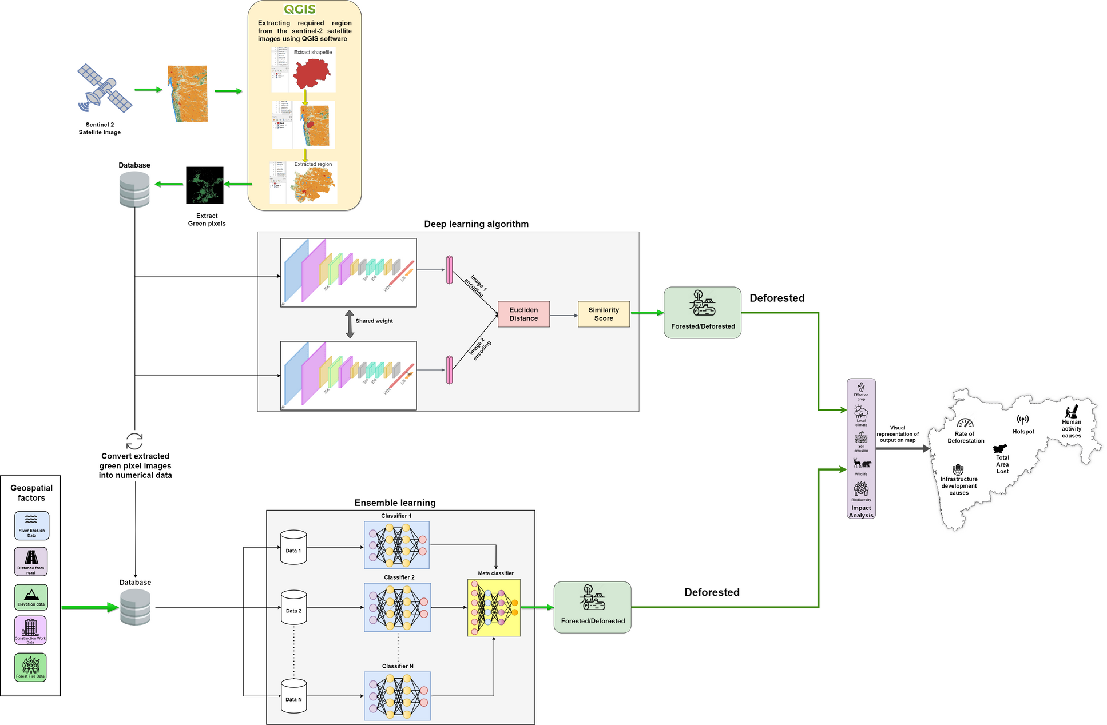
Architecture Diagram

Slide 5
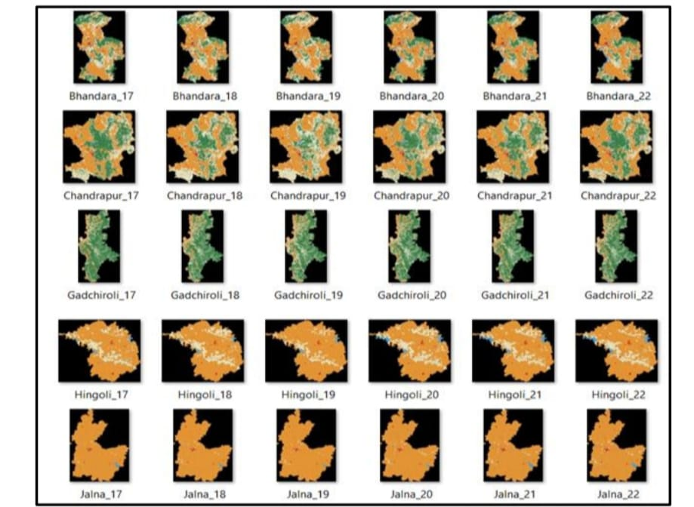
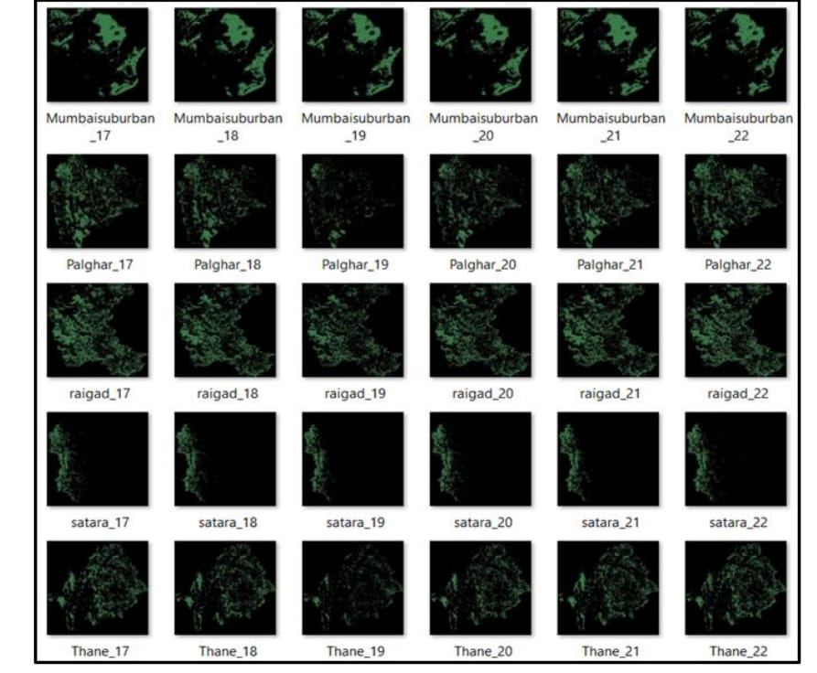

Slide 6
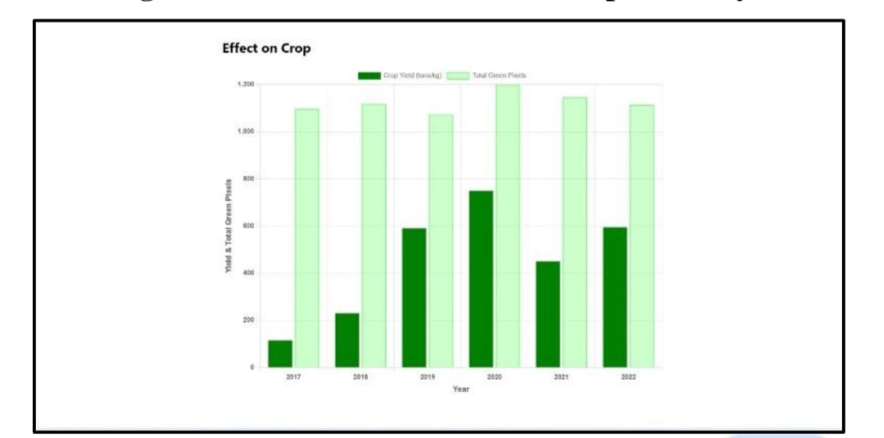
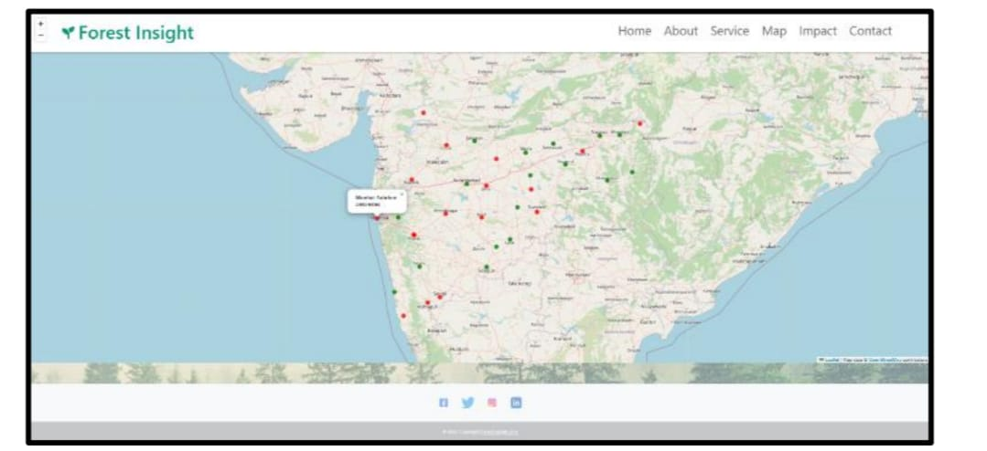


Slide 7
Thank You

